Slide 1


Amazon-Fine-Food-Review-Analysis

Slide 2
Agenda
Introduction
Software requirement specifications and coding & implementation
Conclusions and Project Summary, References
Methodology
Overview of the Data

Slide 3
Abstract
Sentiment analysis or determining the opinion is study about the people’s sentiment, emotions and opinion that is expressed in terms of text. It’s very popular because it helps us in understanding the opinions of other people. Which is the key influencer and important part of almost all human activities. The opinion of the people can be either positive or negative. The main objective of our work is to build a machine learning ensemble model for sentiment analysis. Ensemble strategies combine various learning algorithms to gain optimum performance. The amazon fine food reviews dataset has been used. The proposed model has been evaluated using various performance metrics such as accuracy, recall and precision.
Keywords: sentiment analysis, machine learning, precision, recall, natural language processing, accuracy, amazon fine food reviews.

Slide 4
Introduction
Problem:
Understand how products are doing in the market. How are customers reacting to a particular product what is the consumer’s sentiment across products? Many more questions like these can be answered using sentiment analysis.
Objective: One of the popular NLP industrial applications – sentiment analysis. It is very important from a business standpoint to understand how customer feedback is on the products/services they offer to improvise on the products service for customer satisfaction.
The main objective of this project is find the best model that classifies the review accurately using natural language processing and machine learning techniques. First converting the plain text into vectors using few conversion techniques. Various models such as support vector machine, TF-IDF vectorizer, count vectorizer, logistic regression, multinomial naïve bayes. Are used, among them the model which classifies more accurately is considered as the best classifier by using f1-score accuracy as performance metrics.

Slide 5
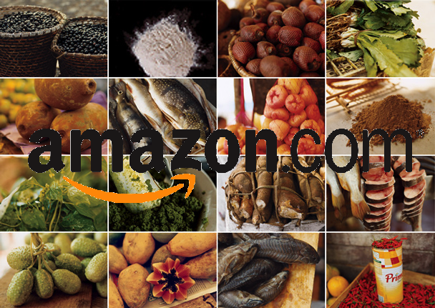
Overview:
Amazon.com is an American multinational technology company focusing on e- commerce, cloud computing, online advertising, digital streaming and artifical intelligence. It has been often referred to as “one of the most influential economic and cultural forces in the world most valuable brands.
Amazon.com is an online retailer and web service provider. The company provides products such as apparel, auto and industrial items, beauty and health products, electronics, grocery, games, jewelry, kids and baby products, music, sports goods, toys, and tools.
Amazon reviews are often the most publicly visible reviews of consumer products. As a frequent amazon user, I was interested in examining the structure of a large database of amazon reviews and visualizing this information so as to be a smarter consumer and reviewer

Slide 6

Software Requirement Specification:
Software Requirement:
Operating system : Windows.
User interface : Jupyter NoteBook.
Platform : JupyterNoteBook.
Database : CSV.
Hardware Requirements:
Processor : CORE i5
Hard disk : 512 GB
RAM : 8GB
Bit : 64 bits

Slide 7




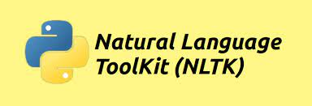




Coding and Implementation

Slide 8
Overview of the Data

Slide 9
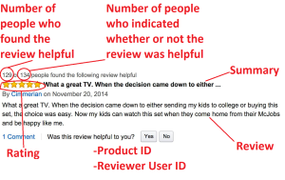
Dataset description:
The dataset is provided by Kaggle website and was collected and published first by Mcauley et al. (2013) in their research related to online reviews. The dataset consists of reviews on fine food posted on Amazon.Com. It has a total of 568,454 reviews on 74,258 products.
1.Id
2.Product Id — unique identifier for the product
3.User Id — unqiue identifier for the user
4.Profile Name
5.Helpfulness Numerator — number of users who found the review helpful
6.Helpfulness Denominator — number of users who indicated whether they found the review helpful or not
7.Score — rating between 1 and 5
8.Time — timestamp for the review
9.Summary — brief summary of the review
10.Text — text of the review
1.Number of reviews: 568,454
2.Number of users: 256,059
3.Number of products: 74,258
4.Timespan: oct 1999 — oct 2012
5.Number of attributes/columns in data: 10
Attribute Information
Source: https://www.kaggle.com/datasets/snap/amazon-fine-food-reviews

Slide 10
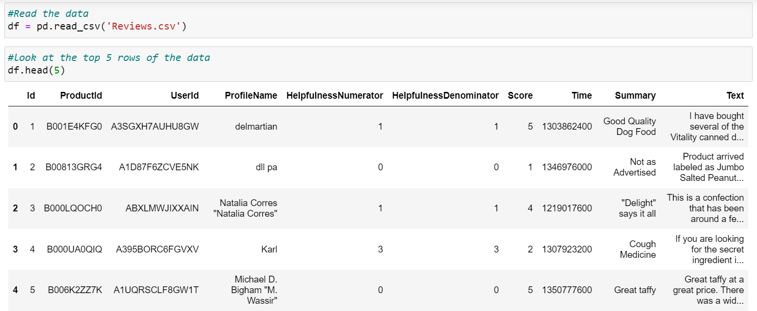
Loading the Data:
The dataset is available in two forms
1. CSV file
2. SQLite database
In order to load the data, we have used the CSV dataset as it easier to query the data and visualize the data efficiently.
I used a database of over 500,000 reviews of amazon fine foods that is available .
When I am loading the dataset using pandas I got this output in Jupiter notebook.

Slide 11
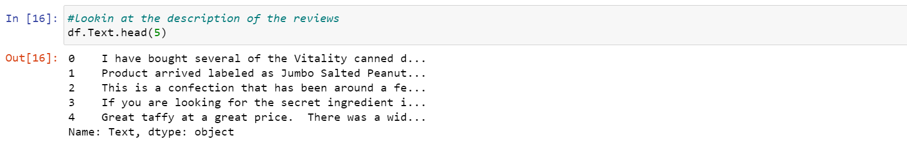
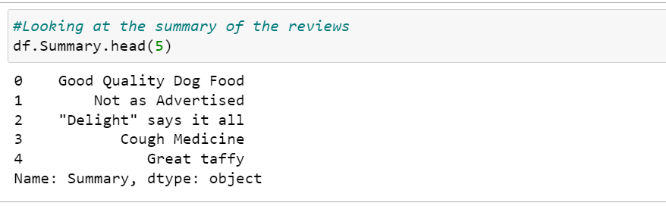
Overview of the review and summary text:
The review text contains a detailed description of the product from the user’s perspective. Moreover, it also describes the overall sentiment of the user toward the product apart from the description of the product itself. Some of the examples of the review text are shown below:
On the other hand, the summary text represents a user’s sentiment in a very confined manner. The information is conveyed in few words in this case. Some of the examples of the summary text are shown below:

Slide 12
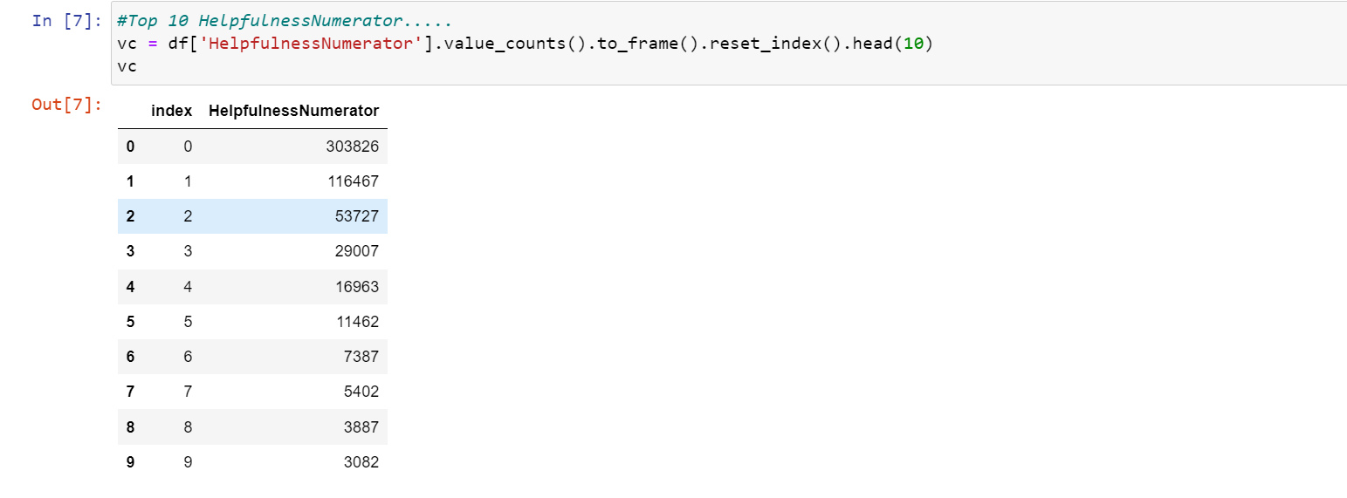
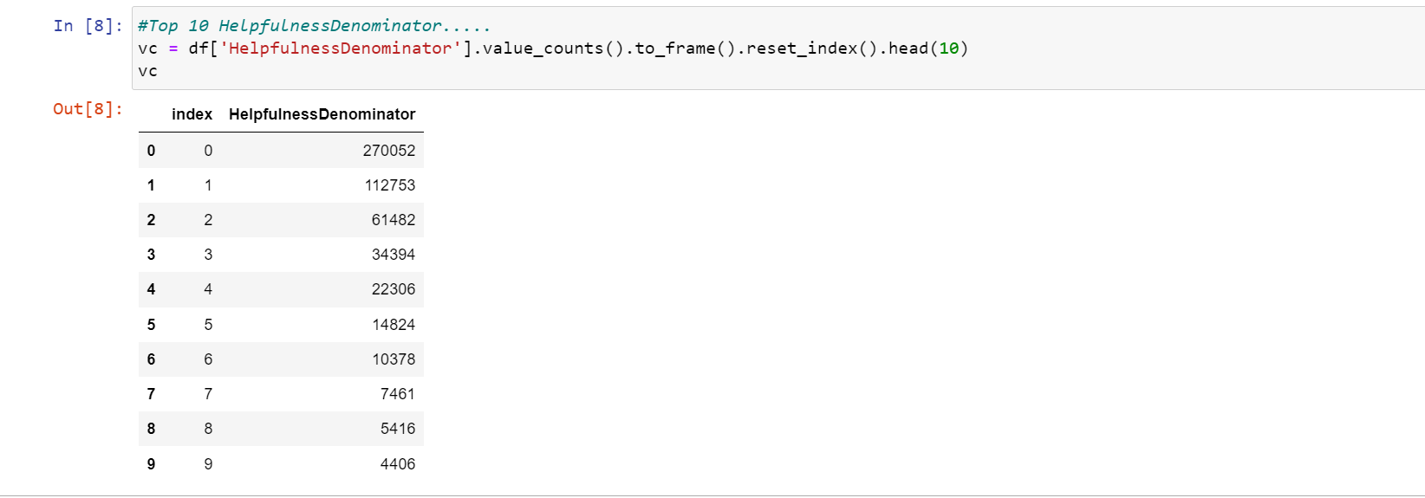
Overview of the Helpfulness Numerator:
Helpfulness numerator: Number of peoples who found the review helpful to them.
Overview of the Helpfulness Denominator:
Helpfulness denominator: number of peoples indicated whether they found the review helpful or not.

Slide 13
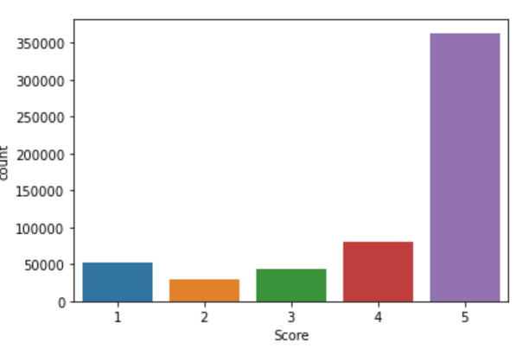
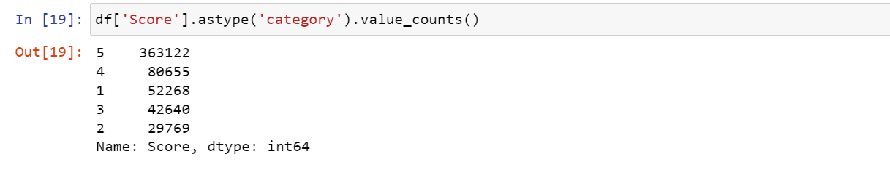
Overview of the Score:
The dataset is that the reviews are higher scores, especially towards the highest score, which is 5. In the 568458 reviews, 52268 reviews are labeled with1, 29769 reviews are labeled with 2, 42640 are labeled with 3, while 80655 reviews are labeled with 4 and an even larger volume of 363122 reviews are labeled with 5.

Slide 14
Methodology
Exploratory Data Analysis
Text Processing
Model training, Model validation
Sentiment scores, Business insights

Slide 15
Exploratory data analysis:

Slide 16
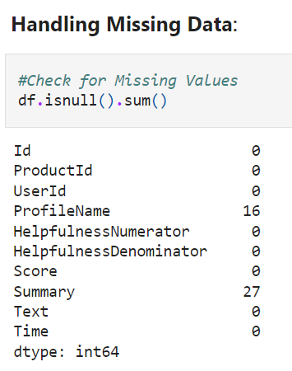
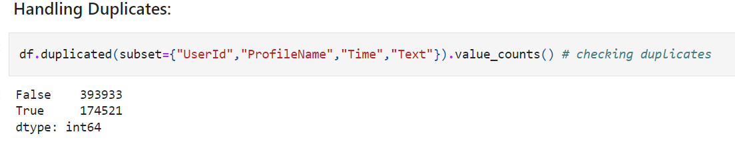
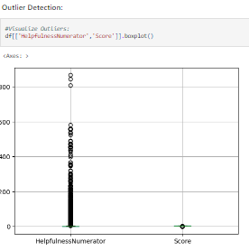
Data Cleaning:Data cleaning is the process of preparing data for analysis by removing or modifying data that is incorrect, incomplete, irrelevant, duplicated, or improperly formatted. This data is usually not necessary or helpful when it comes to analyzing data because it may hinder the process or provide inaccurate results. There are several methods for cleaning data depending on how it is stored along with the answers being sought.

Slide 17
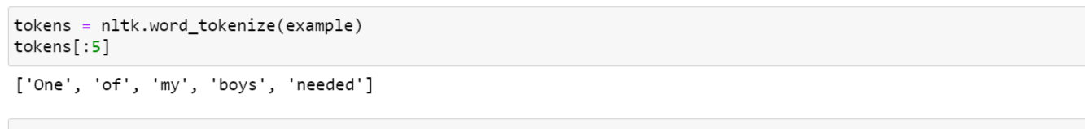
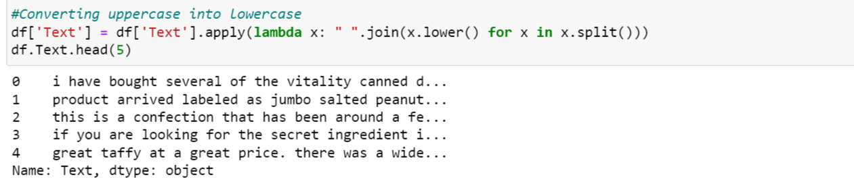
Text Preprocessing
Text preprocessing is an essential step in Natural language processing (NLP) that involves cleaning and transforming unstructured text data to prepare it for analysis. It includes tokenization, stemming, lemmatization, stop-word removal, and part-of-speech tagging.
Tokenization : Tokenization is basically the process of splitting the sentences into words. Each word is then considered as a separate token
Lower casing: converting a word to lower case (NLP -> nlp).

Slide 18
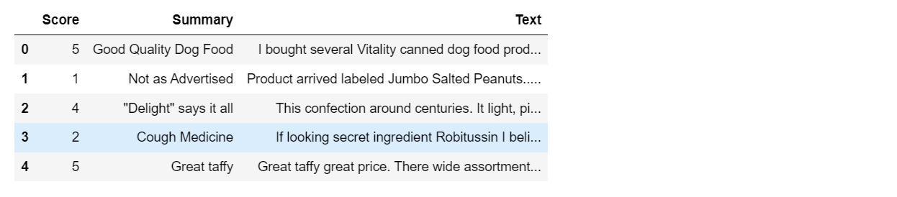
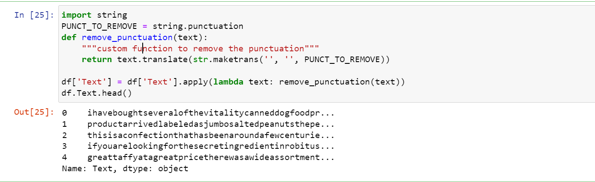
Stop words removal:Stop words are very commonly used words (a, an, the, etc.) These words do not really signify any importance as they do not help in distinguishing two documents.
Removal of punctuation marks : In this step, the punctuation marks are removed from the text as they do not provide any extra information while extracting the semantics from the text.

Slide 19
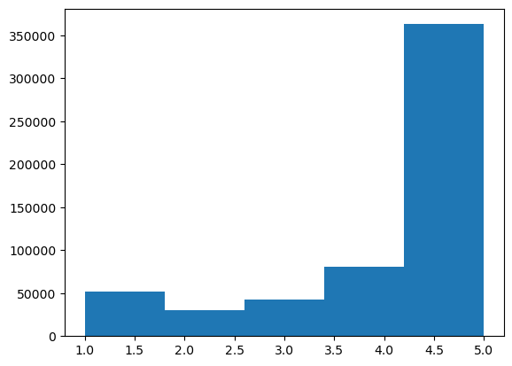
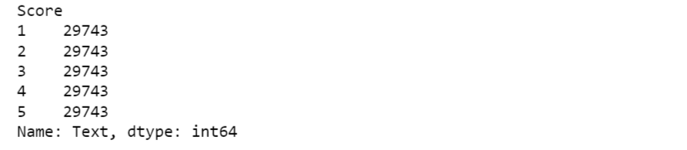
Data on distribution of ratings
I first looked at the distribution of ratings among all of the reviews. We see that 5-star reviews constitute a large proportion (64%) of all reviews. The next most prevalent rating is 4-stars(14%), followed by 1-star (9%), 3-star (8%), and finally 2-star reviews (5%).
Here our target variable would be positive, negative, and
neutral created using score.
Score<= 2: Negative
Score = 3: Neutral
Score>= 4: Positive
We recreate a ‘balanced’ dataset.

Slide 20
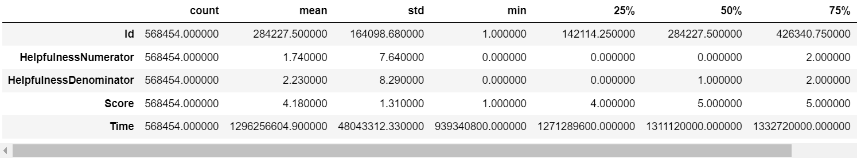
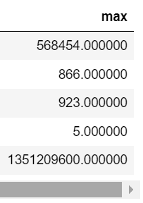
Basic statistics:-
Descriptive statistics:The data is summarised and explained in descriptive statistics. The summarization is done from a population sample utilising several factors such as mean and standard deviation. Descriptive statistics is a way of organising, representing, and explaining a set of data using charts, graphs, and summary measures. Histograms, pie charts, bars, and scatter plots are common ways to summarise data and present it in tables or graphs.
This reduces the number of observations from the original 568,454 to 298,402. Examine the distribution of the attributes amazon food reviews by looking at their descriptive statistics.

Slide 21
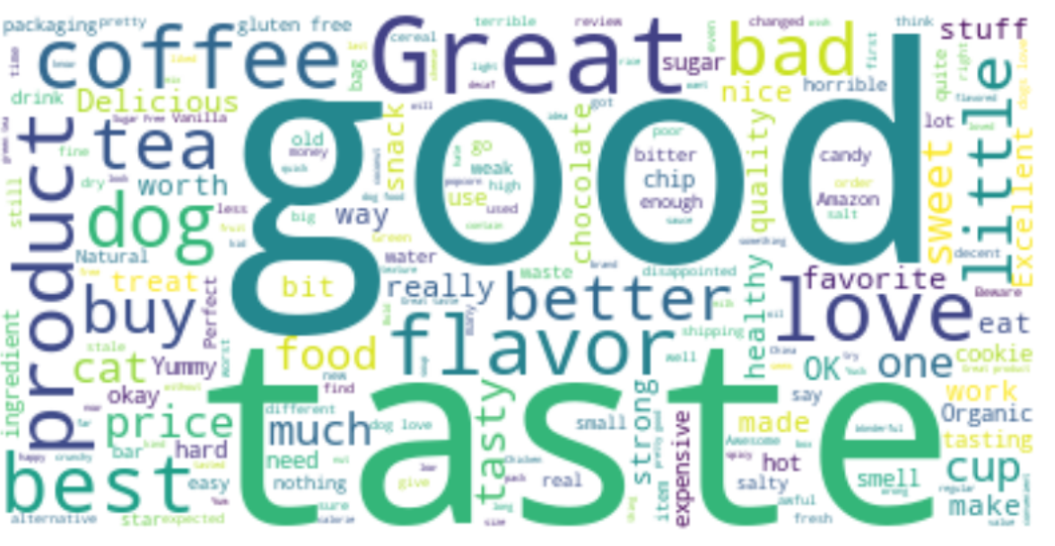
Word cloud:
The core of the wordcloud library is the wordcloud class, and all functions are encapsulated in the wordcloud class. When using, you need to instantiate a wordcloud object, and call its generate(text) method to convert the text into a word cloud.
Word cloud looking at the ‘Summary’ text

Slide 22
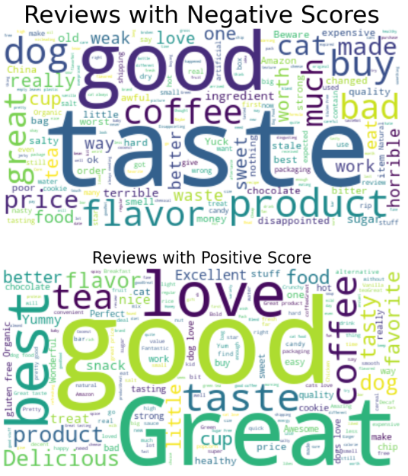
The code to produce these word clouds is included below.
Common words in positive, negative reviews. Let's split the data into negative(score is 1 or 2) and positive(4 or#5) reviews.

Slide 23
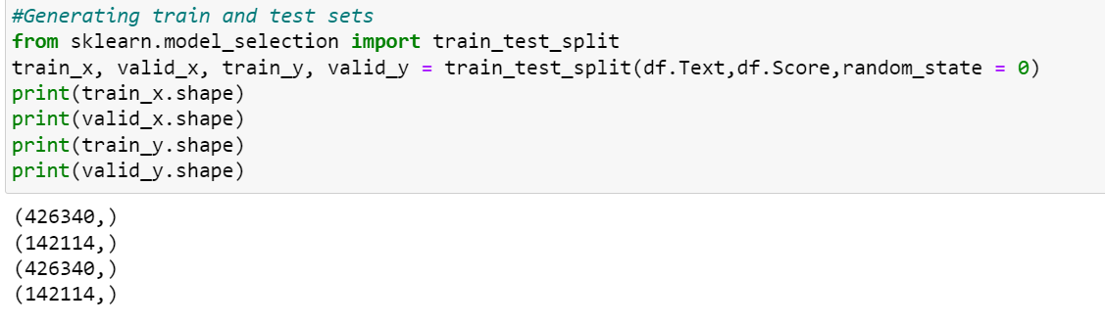
Splitting the data
Split the data into train and validation:
This study uses the hold-out method to split the original dataset into train and test sets. The dataset is shuffled and divided into train and test sets with the ratio 7:3 for all the approaches used in the study.

Slide 24
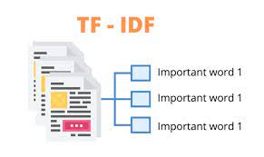
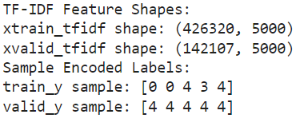
TF-IDF vectorizer
TF-IDF is the simple product of TF and IDF so that both of the drawback’s are addressed which makes predictions and information retrieval relevant.
Term frequency(Tf): Term frequency is simply the ratio of the count of a word present in a sentence to the length of the sentence. TF is basically capturing the importance of the word irrespective of the length of the document.
Inverse document frequency(idf): IDF of each word is the log of the ratio of the total number of rows to the number of rows in a particular document in which that word is present.
IDF = log(N/n)
WHERE: (N) IS THE TOTAL NUMBER OF ROWS AND
(n) IS THE NUMBER OF ROWS IN WHICH THE
WORD WAS PRESENT.
Feature engineering:
Review text, preprocessed one converted into vectors using (TFIDF

Slide 25
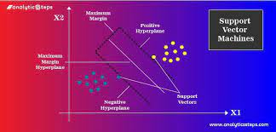
Support Vector Machine:
Machine learning algorithm for classification:
Support vector machine or SVM is one of the most popular supervised learning algorithms, which is used for classification as well as regression problems. However, primarily, it is used for classification problems in machine learning.
The goal of the svm algorithm is to create the best line or decision boundary that can segregate n-dimensional space into classes so that we can easily put the new data point in the correct category in the future. This best decision boundary is called a hyperplane.
Svm chooses the extreme points/vectors that help in creating the hyperplane. These extreme cases are called as support vectors, and hence algorithm is termed as support vector machine.

Slide 26
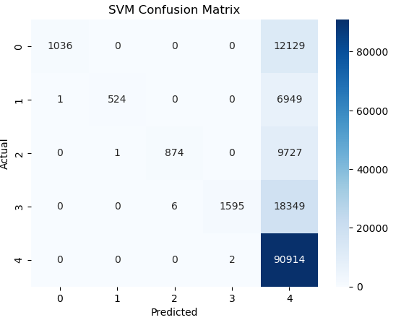
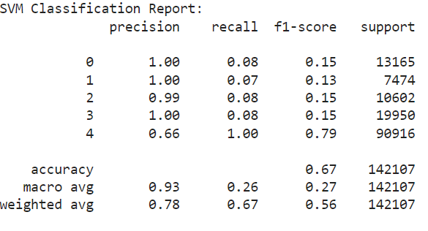
Model performance ( Accuracy, Precision, Recall,F-score) SVM Classification Report
Confusion-matrix

Slide 27
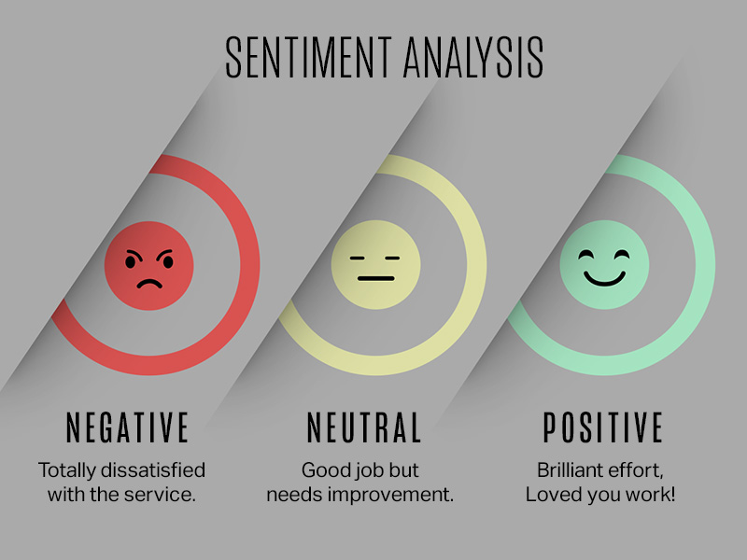
Sentiment Analysis
Sentiment analysis, also known as opinion mining, is a natural language processing (NLP) problem which means identifying and extracting subjective information of text sources. The purpose of sentiment classification is to analyze the written reviews of users and classify them into positive or negative opinions, so the system does not need to completely understand the semantics of each phrase or document.

Slide 28
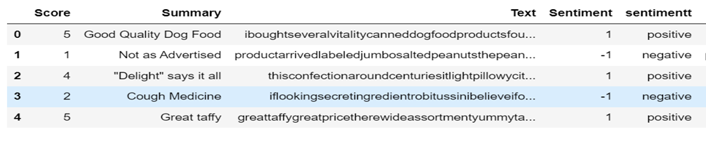
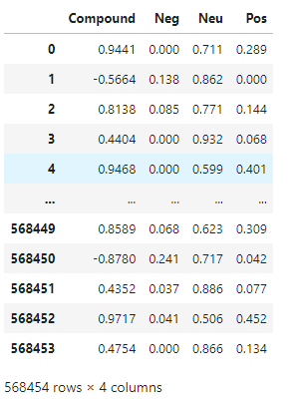
Sentiment scores
Sentiment analysis: pretrained model takes the input from the text description and outputs the sentiment score ranging from -1 to +1 for each sentence.

Slide 29
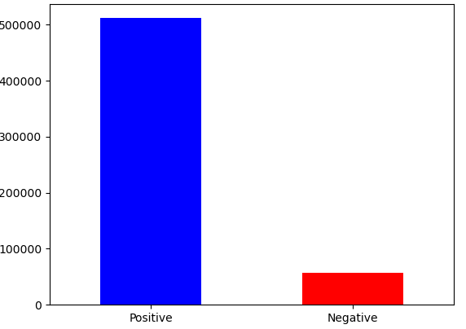
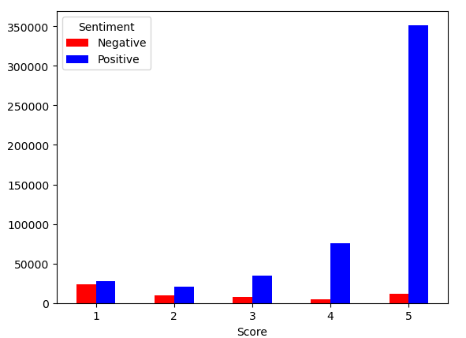
Business insights
A business insight combines data and analysis to find meaning in and increase understanding of a situation, resulting in some competitive advantage for your business. This provides more than low-level understanding of an issue, giving you deeper insight into major mechanics related to your particular business.
Many people agree with score 5 reviews
Just took a sample of all reviews and completed sentiment analysis. If you look, more than 90% reviews are positive, which is really good for any business.

Slide 30
References:
McAuley, J.J. And Leskovec, J., 2013, may. From amateurs to connoisseurs: Modeling the evolution of user expertise through online reviews. In proceedings of the 22nd international conference on world wide web (pp. 897-908). ACM
Natural language processing recipes: unlocking text data with machine learning and deep learning using python. Akshay Kulkarni, Adarsha shivananda,2019.
NLTK(www.Nltk.Org(http://www.Nltk.Org/)
Text blob (http://textblob.Readthedocs.Io/en/dev/
Scikit-learn user guide. Https://scikitlearn.Org/stable//downloads/scikit-learn-docs.Pdf.
Hands on machine learning with scikit-learn, Keras and Tensor flow. AurelienGeron.
GitHub Code link: https://github.com/dattesh2507/Amazon-Fine-Food-Review-Analysis

Slide 31


